Slide 1

COALITION of WEATHER BOIS
(COW-BOIS)
Topic: Final Design Review
Members:
Gantzen Miller
Kennedy Jones
Pete Ozegovic
Ben Rogers
Christian Evans
Abdullah Ali
Notes:
Gantzen Miller - Introduction

Slide 2
Objectives, Significance, Novelty
Objective:
Significance:
Novelty:
Design a remote weather station to be comparable with existing weather stations for the K-State Mesonet [1]
Provide accurate and reliable data
Provide more documentation to compare previous weather patterns to.
Provide lifesaving weather data to underserved communities
Learn more about microclimates within Kansas
Help farmers more accurately predict and understand weather patterns
Compact
Durable
Easily serviceable
Exceeds current capability of the product
Long range communication
Notes:
Kennedy

Slide 3
DESIGN REQUIREMENTS
ID | Project Requirement | Description
1.0 | Cost Efficiency (<$19,000) | Total cost of $600 - $800
2.0 | Wireless Transmission of Data Distance being >= 410 Miles | Transmit data values to a server across Kansas
3.0 | Easily replaceable sensors (Convenient maintenance) | Plug and unplug approach in case something breaks (modularity)
4.0 | Off Grid Power Capabilities in a remote area | Self-sustaining system with the ability to power and charge itself
5.0 | Size Maximum | 1.5ft x 1.5ft x 1.5ft
5.1 | Size Minimization | Decrease size as much as possible
6.0 | Sensor Accuracy | Following Page
Notes:
Ben

Slide 4
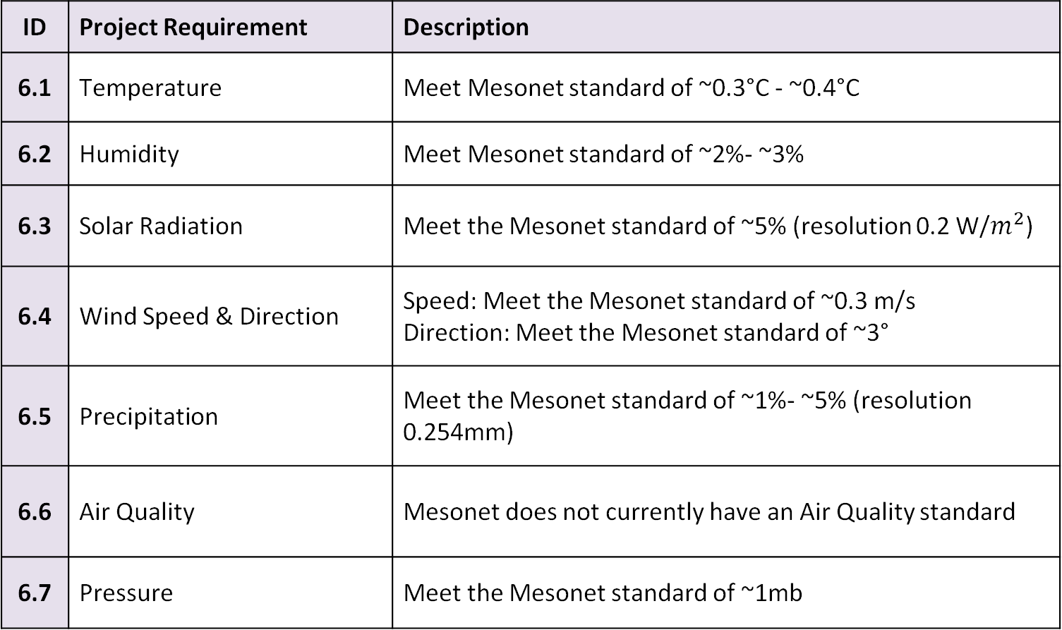
DESIGN REQUIREMENTS (Continued)
ID | Project Requirement | Description
6.1 | Temperature | Meet Mesonet standard of ~0.3°C - ~0.4°C
6.2 | Humidity | Meet Mesonet standard of ~2%- ~3%
6.3 | Solar Radiation | Meet the Mesonet standard of ~5% (resolution 0.2 W/$m^{2}$)
6.4 | Wind Speed & Direction | Speed: Meet the Mesonet standard of ~0.3 m/s Direction: Meet the Mesonet standard of ~3°
6.5 | Precipitation | Meet the Mesonet standard of ~1%- ~5% (resolution 0.254mm)
6.6 | Air Quality | Mesonet does not currently have an Air Quality standard
6.7 | Pressure | Meet the Mesonet standard of ~1mb
Notes:
Ben

Slide 5
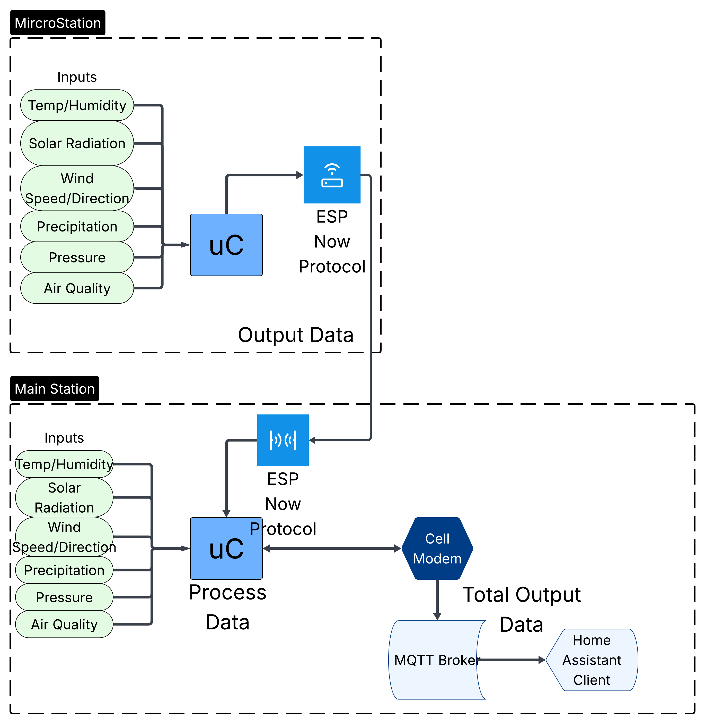
APPROACH, METHODS, PROCEDURES Hardware Block Diagram
Notes:
Ben

Slide 6
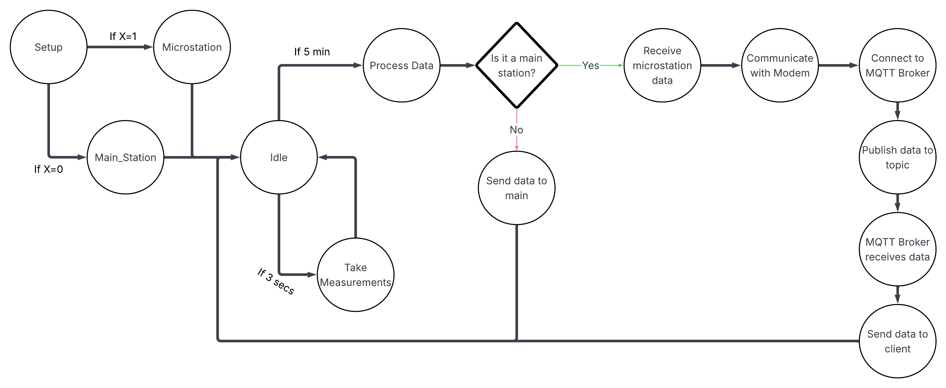
APPROACH, METHODS, PROCEDURES Programming Block Diagram
Notes:
Pete

Slide 7
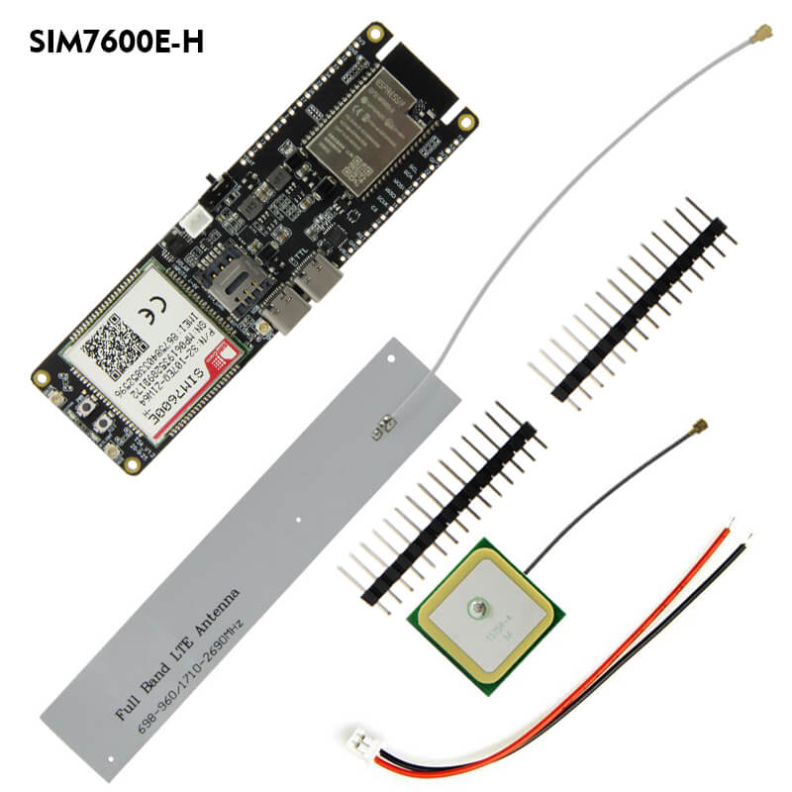
MQTT TRANSMISSION TESTING
MQTT Connectivity Test
Main station must publish to the MQTT Broker.
Publish test message for 10 min.
Passes if no more than 1% of messages fail.
LILYGO T-SIM7600E-H
MQTT Data Integrity Test
No corrupted or partial payloads
Compared published vs. received JSON.
Passes if there is a 100% match.
Notes:
Pete

Slide 8
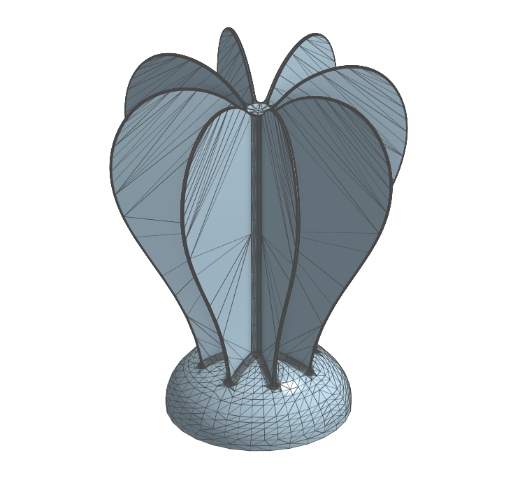
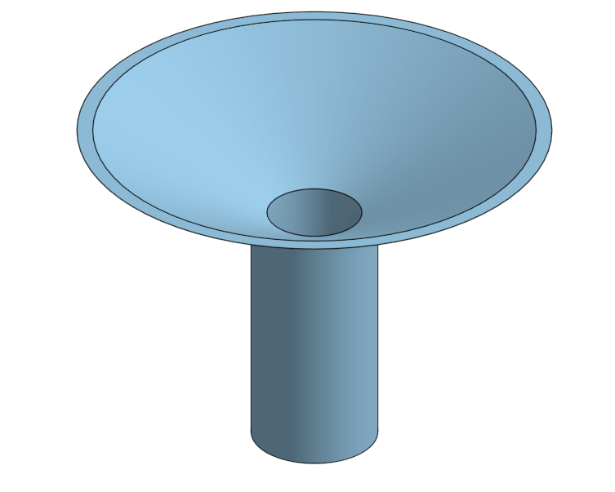
TESTING & DESIGN FOR SENSORS
Working on building sensors
Wind Speed and Direction – Printed the fan, haven’t done testing [2]
Precipitation – Designing the funnel system and testing the load cell
Notes:
Gantzen

Slide 9
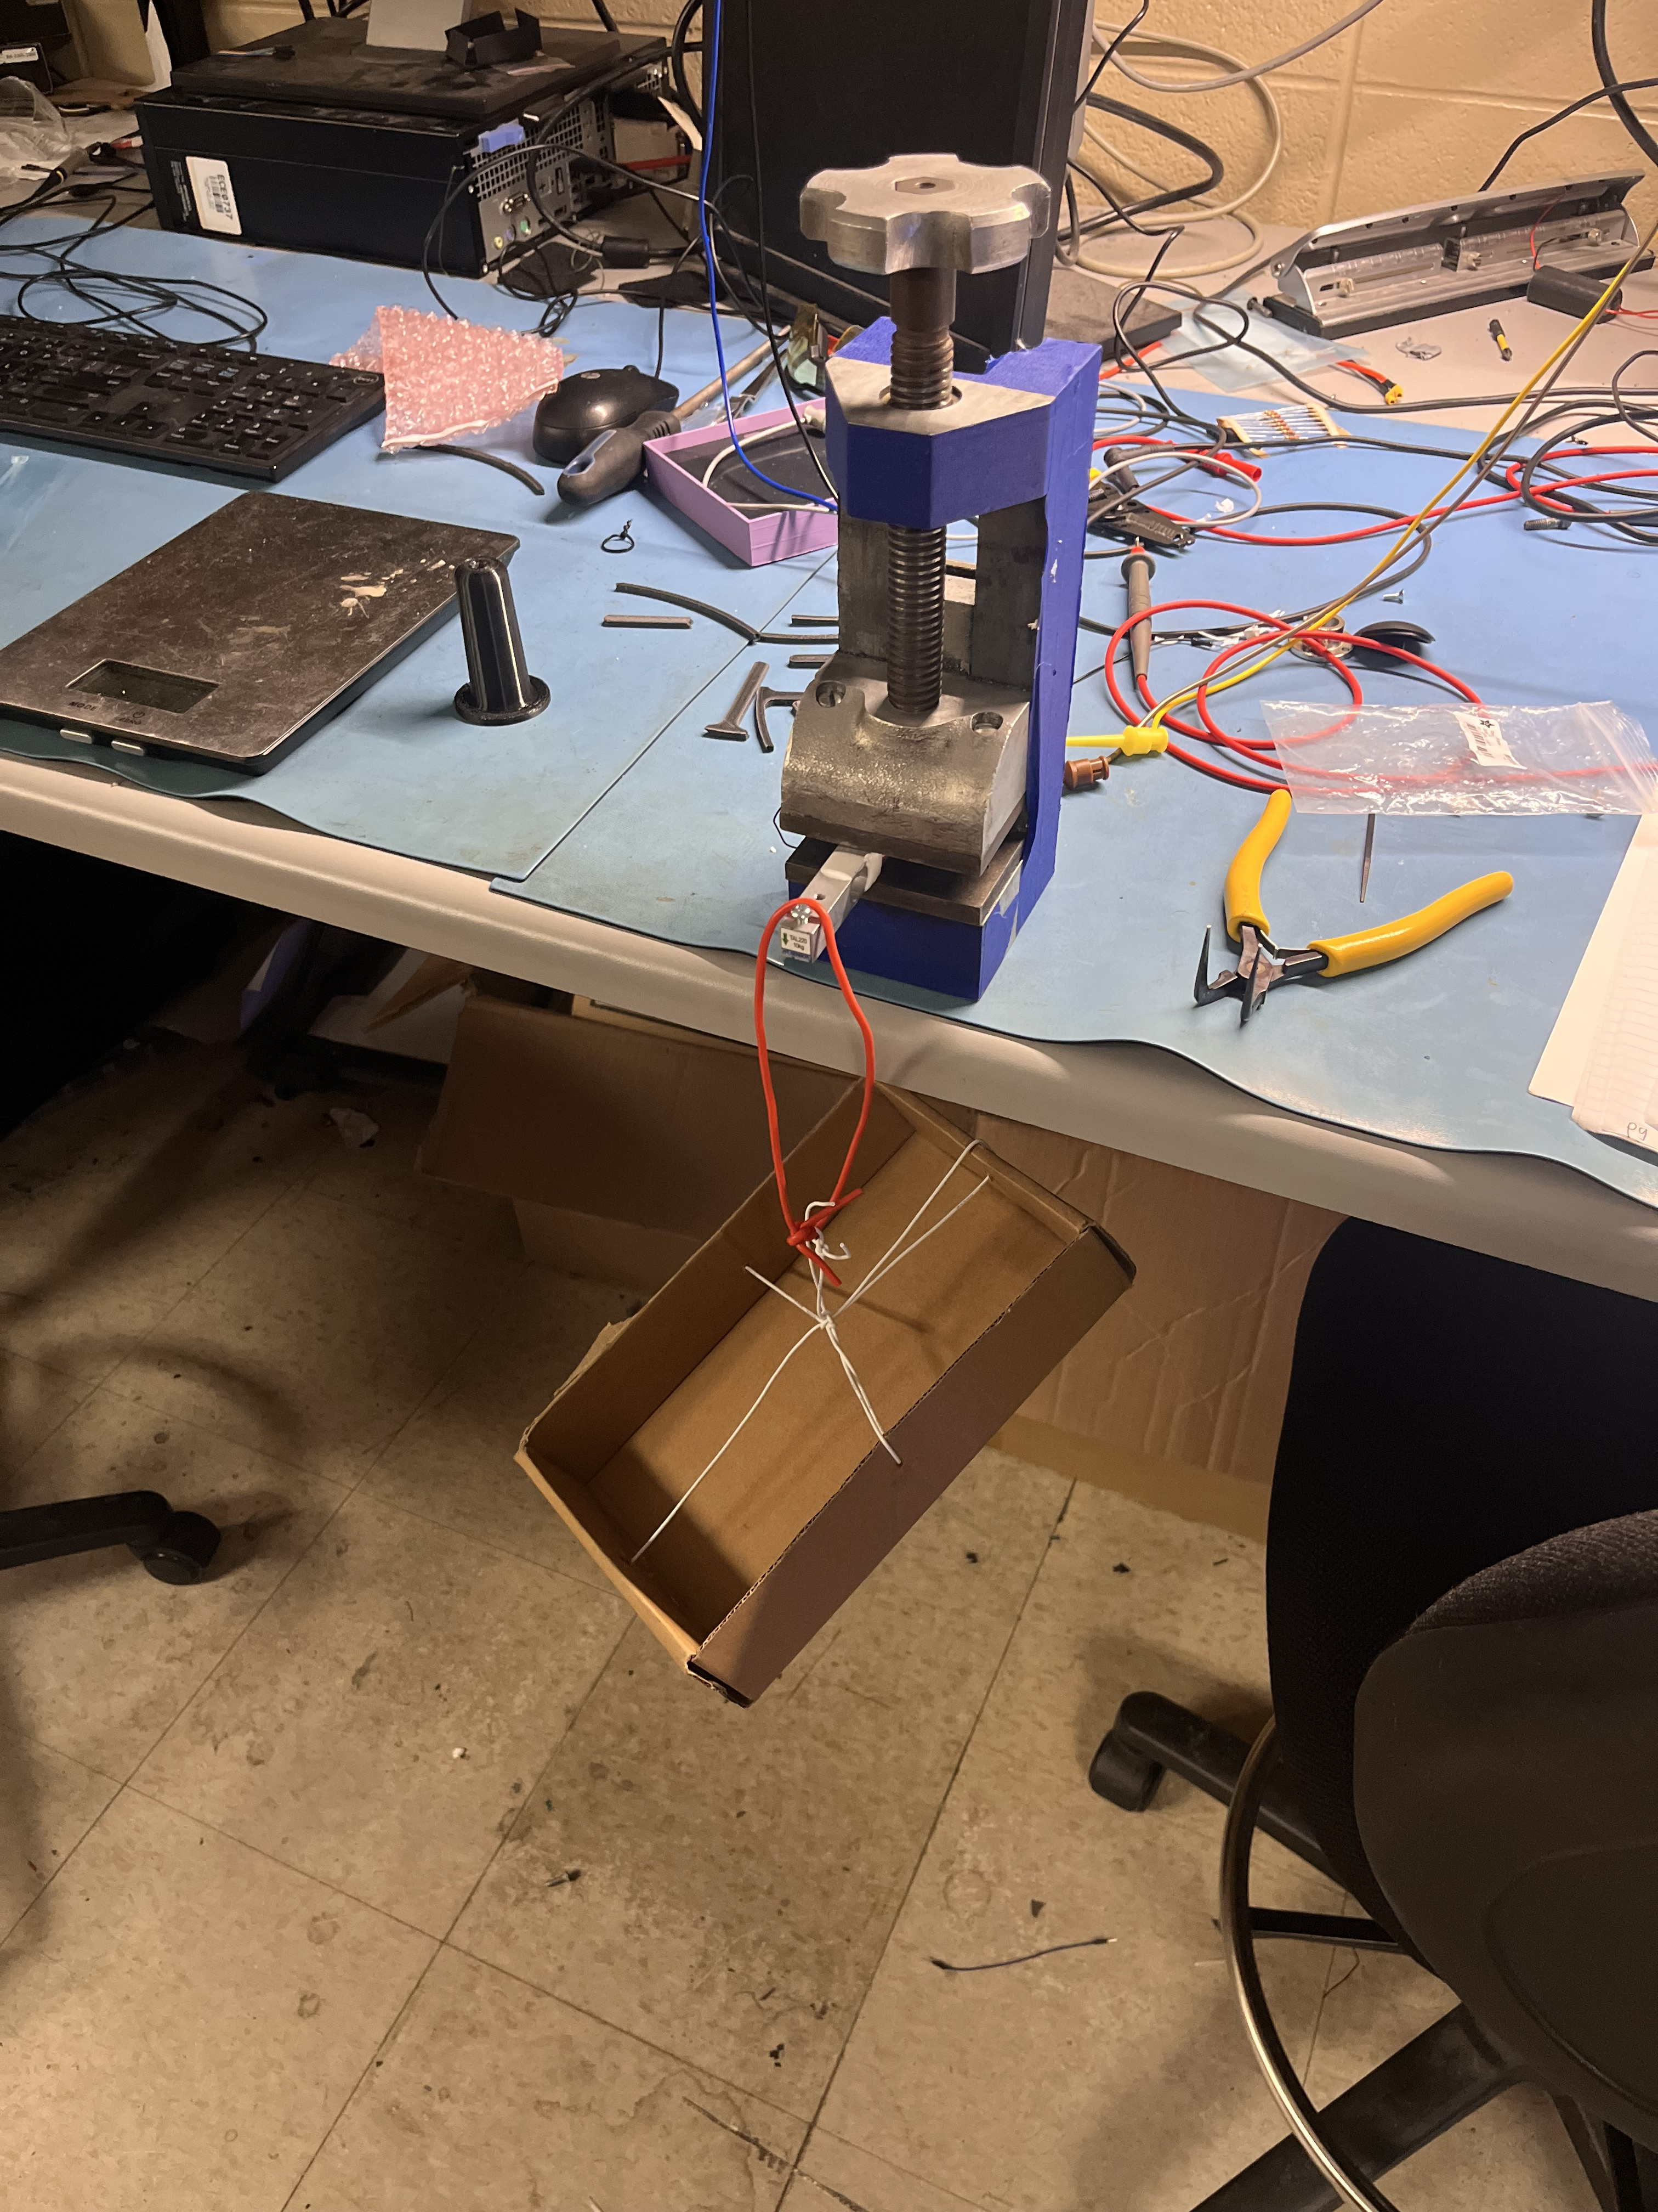
TESTING PRECIPITATION
Testing Precipitation Sensor:
Using a Loadcell to measure the weight of the water
Testing with incrementing loads
Notes:
Gantzen

Slide 10
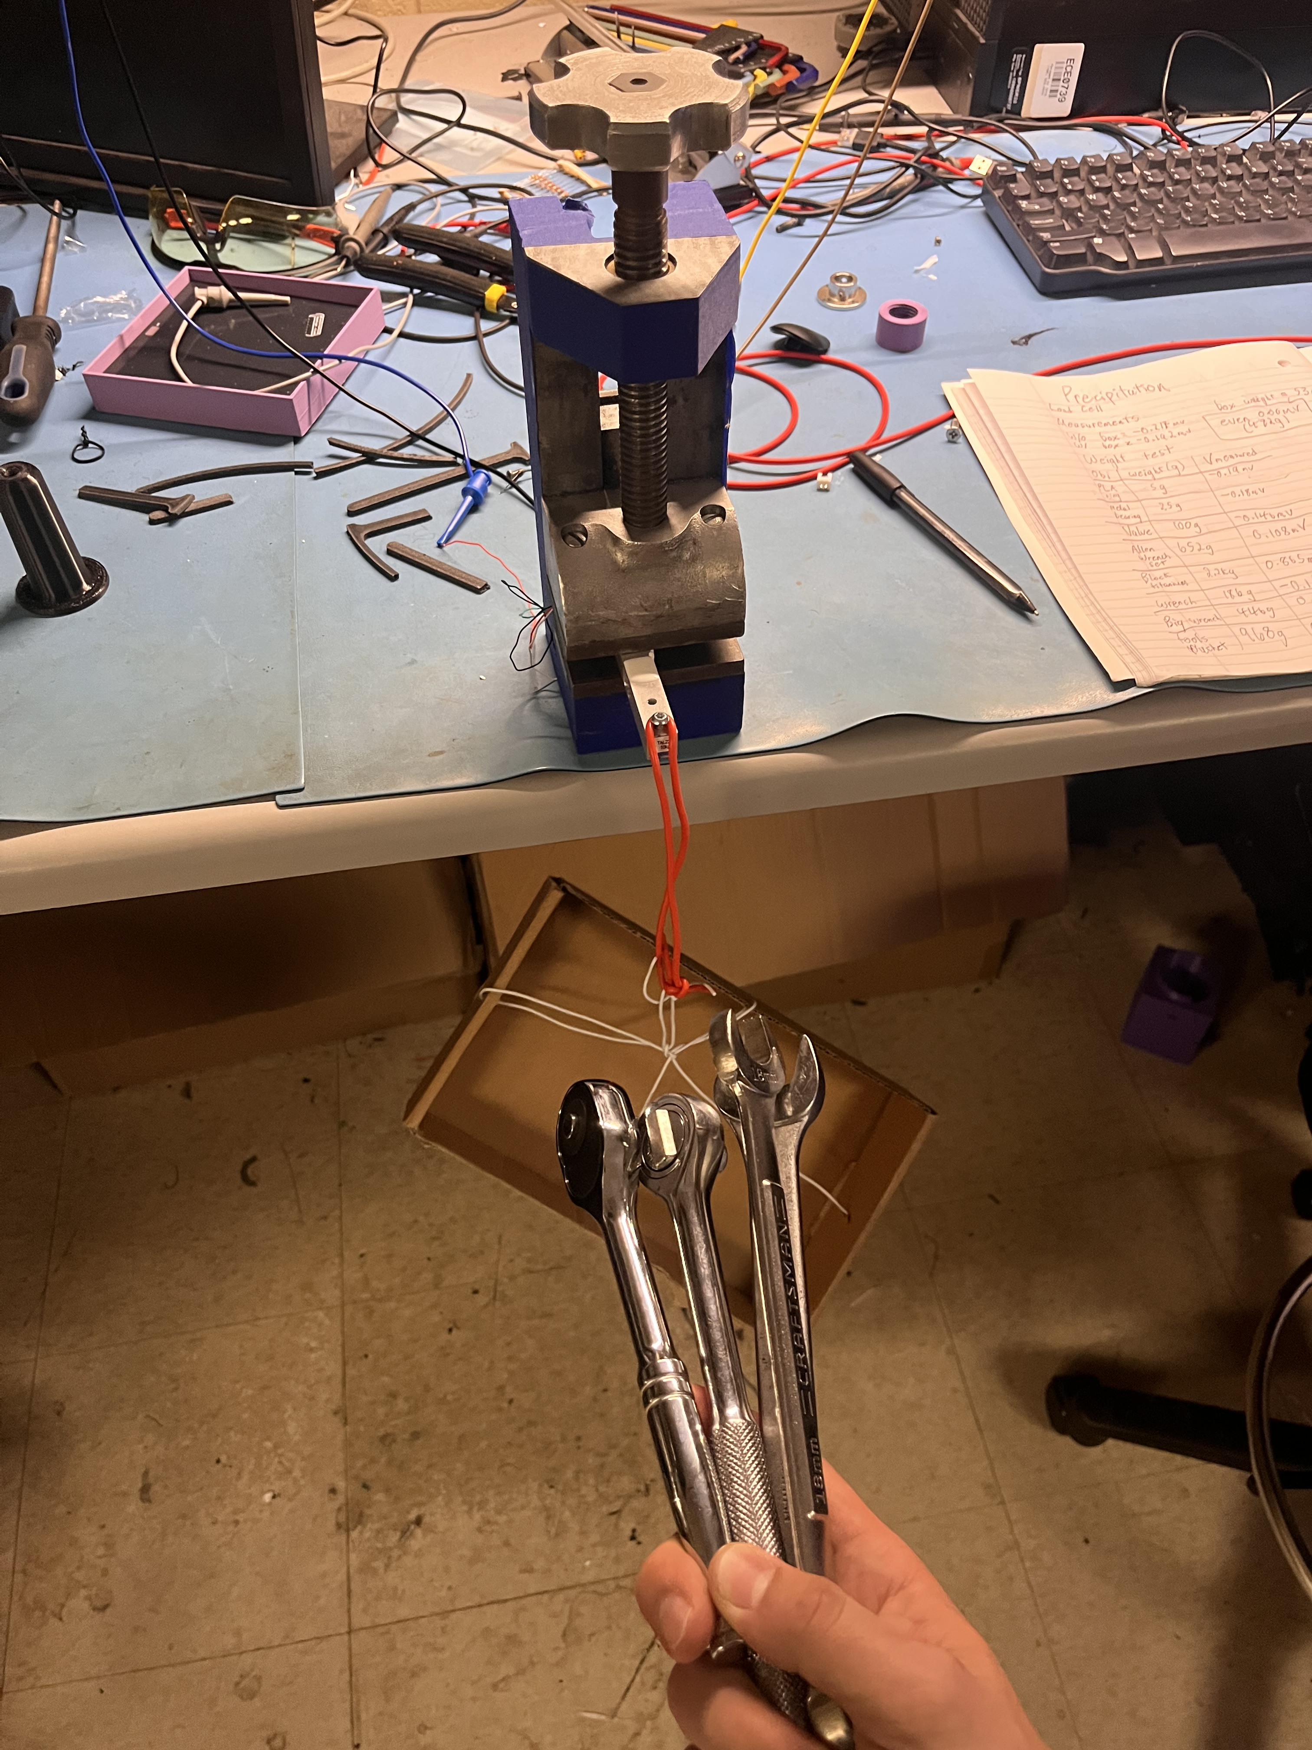
TESTING PRECIPITATION
Notes:
Gantzen

Slide 11
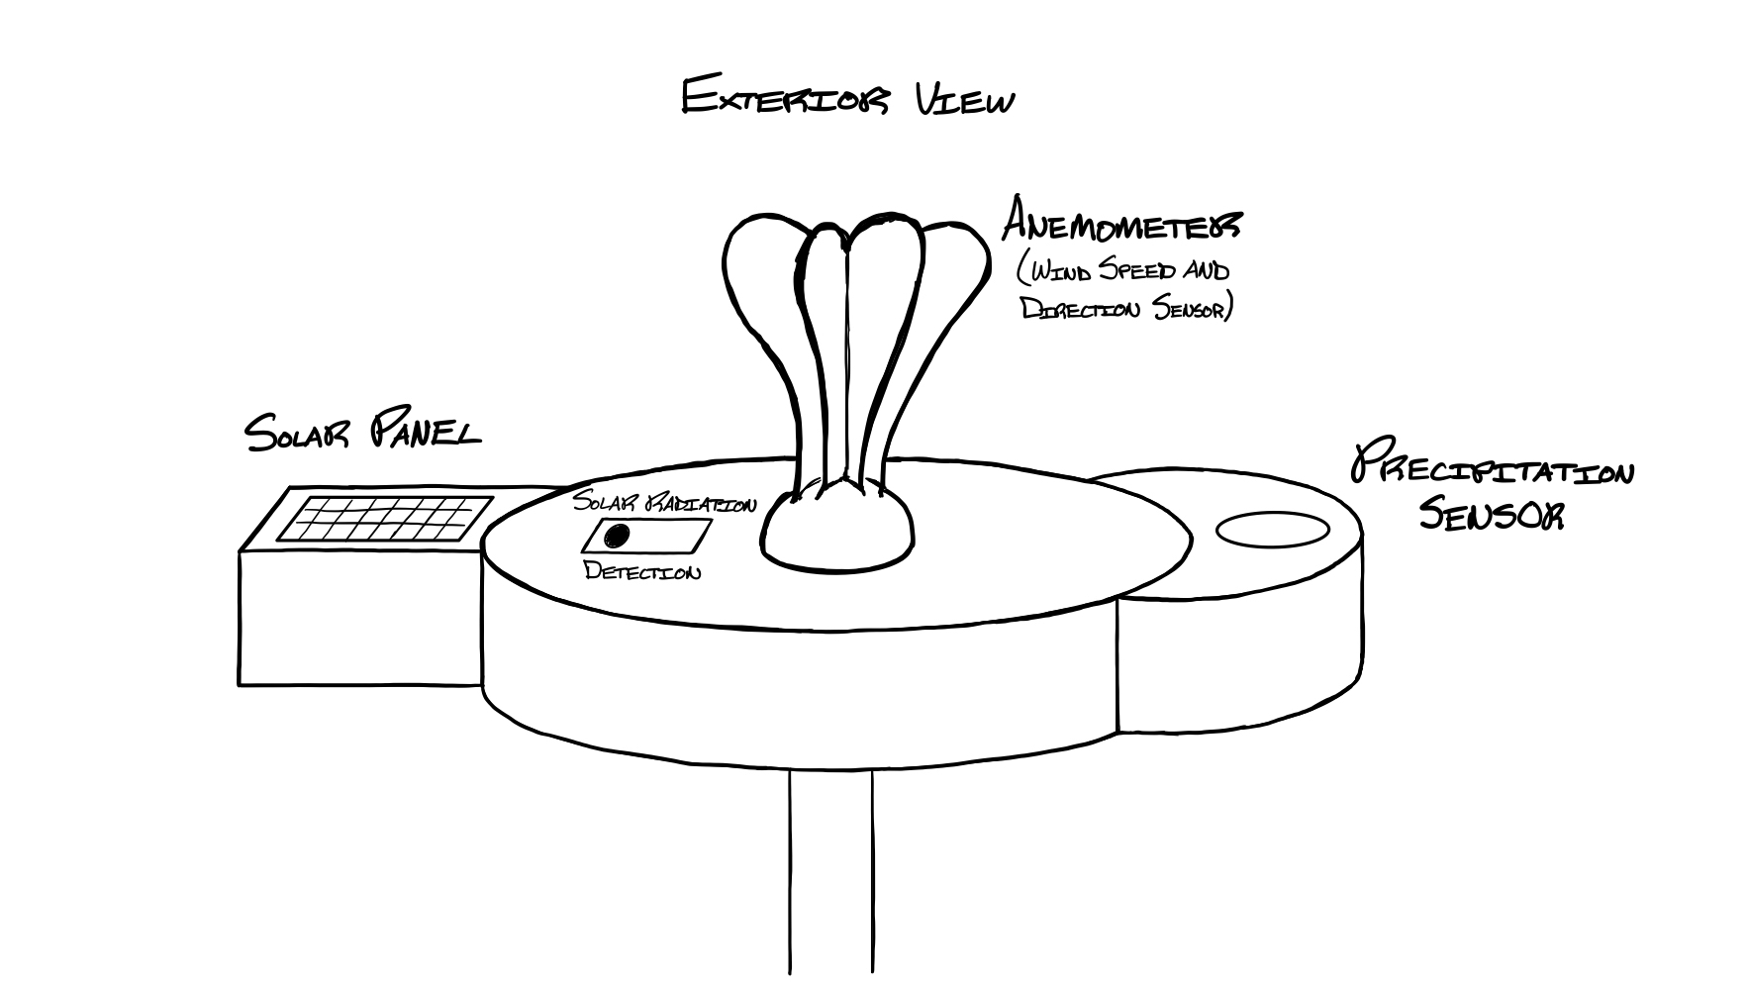
FINAL PRODUCT DRAWING
Notes:
Christian
Rough exterior concept sketch of our final design. The housing will be 3D printed out of PETG plastic.

Slide 12
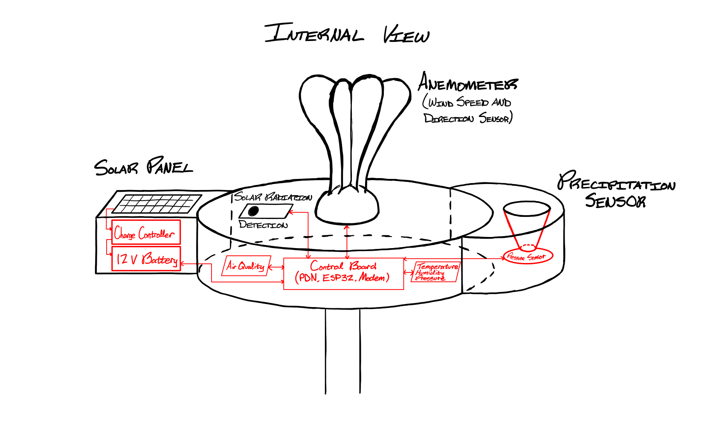
FINAL PRODUCT DRAWING (Continued)
Notes:
Christian
Sketch showing the interior layout of the components that make up our final design.
The central control board will be a custom PCB containing the PDN, microcontroller, and modem. The AQ sensor, temperature sensor, and solar radiation sensor will interface to the board with I2C, and the anemometer and precipitation pressure sensors will be interfaced directly to the board. The solar panel on the left will be connected to the battery with a charge controller in between, and the battery will of course feed the PDN on the main PCB board.

Slide 13
VERIFICATION PLAN
ID # | Project Requirement | Standard | Analysis | Demonstration | Inspection | Test | Description
1.0 | Cost Efficiency (<$19,000) | Technical Overview of KS Mesonet [1] | X |  |  |  | Mathematically calculate the cost of the station
2.0 | Wireless Transmission of Data Distance being >= 410 Miles | FCC Title 47 CFR Part 15 [3] & 3GPP System Architecture |  |  | X |  | This is assumed to be true when using a cellular modem
3.0 | Easily replaceable sensors (Convenient maintenance) | Adafruit Stemma QT Connectors [4] & NXP UM10204: [5] |  | X |  |  | Sensors will be connected and disconnected to be easily replaced using plugs
4.0 | Off Grid Power Capabilities in a remote area | IEEE Std 1547.9-2022 & IEEE Std 2030.2.1-2019 [6] |  |  |  | X | Using a solar panel and battery setup to test if system works in remote location
5.0 | Size maximum (1.5ft x 1.5ft x 1.5ft) |  |  |  | X |  | Size maximum given by our client
5.1 | Size minimization |  |  | X |  |  | Working on minimizing the design as much as possible
Notes:
Gantzen
Inspection for Wireless Transmission Data

Slide 14
VERIFICATION PLAN (Continued)
ID # | Project Requirement | Standard | Analysis | Demonstration | Inspection | Test | Description
6.0 | Sensor Accuracy | Kansas Mesonet Network Architecture[7] |  |  |  | X | Comparing collected data to what the Mesonet already collects
6.1 | Temperature |  |  |  |  | X | Sensor Compares to ~0.3°C - ~0.4°C
6.2 | Humidity |  |  |  |  | X | Sensor Compares to ~2% - ~3%
6.3 | Solar Radiation |  |  |  |  | X | Sensor Compares to ~5% (Resolution 0.2 W/m^2)
6.4 | Wind Speed Wind Direction |  |  |  |  | X | Sensor Compares to ~0.3 m/s ~3°
6.5 | Precipitation |  |  |  |  | X | Sensor Compares to ~1% - ~5% (Resolution 0.254mm)
6.6 | Air Quality |  |  |  |  | X | Nothing Original to compare to
6.7 | Pressure |  |  |  |  | X | ~1mb
Notes:
Gantzen

Slide 15
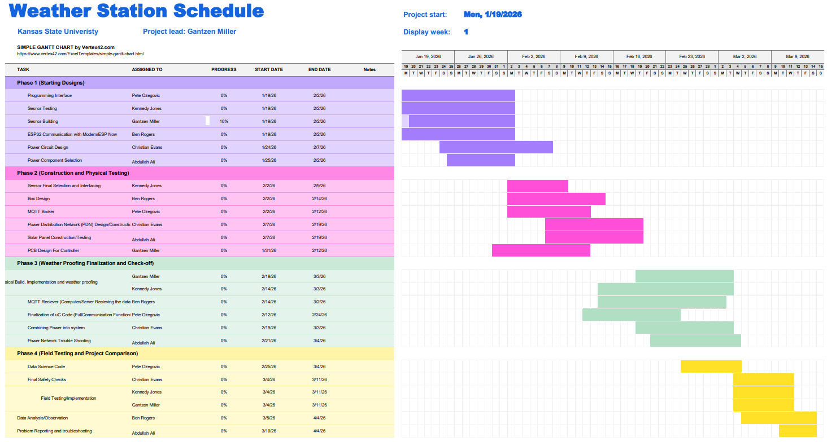
GANTT CHART
Notes:
Gantzen

Slide 16
BUDGET BREAKDOWN
Section: | Estimated Cost: | Parts and Ideas Included:
Sensors | $200 | Measuring Devices, Parts
Board/Modem | $200 | PCB Construction, PDN, Battery/Charge Control, Modem,
Packaging/Mechanical | $200 | PETG, Weather Proofing epoxy, Station Mounting Rod, etc.
Additional Funds | $200 (Maximum) | Problems, Data Plan, Manufacturing Costs
Total | $600-$800
Notes:
Abdullah

Slide 17
CURRENT EXPENDITURES WITH BUDGET BREAKDOWN
Category: | Cost: | Items Purchased:
Sensors | $97.94 | PCB Sensors and parts for constructed sensors
Board/Modem | $67.50 | T-SIM7600E/G/SA-H
Total Spent | $165.44
Section: | Current Budget Amount:
Sensors | $102.06
Board/Modem | $132.50
Packaging/Mechanical | $200
Additional Funds | $200 (Maximum)
Total Budget Left | $634.56
Notes:
Abdullah

Slide 18
FEASIBILITY – General and Sensors
Risk/Concern | Feasibility/Risk Mitigation | Responsible Parties
Timeline | Our timeline is feasible. We have ordered sensors and completed what we intended in the first semester. | Everyone
Sensor Accuracy | Ensure the sensors are accurate to Mesonet standards. If not, we will need to find another sensor that fulfills our needs. | Gantzen Miller and Kennedy Jones
Size | With the size of our sensors, we believe a small and compact design will be able to be achieved. | Ben Rodgers
Sensor Replacement | Using the Stemma QT connectors ensures that if a product becomes unavailable, an equivalent sensors will be able to be easily installed. | Gantzen Miller and Kennedy Jones
Weather proofing | Sensors and housing will be tested individually to ensure double protection against the elements. | Ben Rodgers and Kennedy Jones
Notes:
Kennedy

Slide 19
FEASIBILITY – Power Related
Risk/Concern | Risk Mitigation | Responsible Parties
Undercharging | Ample battery sizing with worst case sunlight data calculated in. What is the worst possible generation for different time spans? | Christian Evans and Abdullah Ali
Overcharging | Charge controller system placed in PDN between solar panel and battery | Christian Evans and Abdullah Ali
Incorrect Sizing | Ample simulation and rigorous worst-case testing pre-selection of panel and battery (amp hour safety margin) | Christian Evans and Abdullah Ali
PCB Design Experience | Reliance on teammates with design experience (Gantzen) | Christian Evans and Gantzen Miller
Control System Design Experience | Preexisting convertor design with well documented control system design (aka READ THE DATASHEETS) | Christian Evans and Abdullah Ali
Notes:
Christian
One big risk we must plan for in advance is an insufficient power generation. We must size the battery and solar panel with a safety margin to avoid potentially harming the components of our system during power tight hours.
Another big risk is possible overgeneration. During the summertime, with extended daylight hours, we may have to handle a larger amount of generation than average. The implementation of a charge controller can help with this issue.
BRIEFLY MENTION ABOVE STATEMENTS AND MAINLY FOCUS ON THE NOTES BELOW
The main edition to the aforementioned risks in our CDR encompasses the risk of both over and under charging. If we happen to make an error when sizing the battery and solar panel, issues could very easily and catastrophically ripple into more issues with over and undercharging. Mainly, if our battery is sized too small, we could run into more frequent under and overcharging, and if the solar panel is too small, undercharging will always be an issue. Therefore, it is imperative that we triple check our calculations for errors and consider the worst possible conditions our system may be under. It will also be beneficial to implement a 10 to 15% margin to our final amp hour calculation.
Considering the team’s abilities last, two concerns are apparent: first, lack of experience in PCB design. Neither Abdullah nor I have done any PCB design, so we will be consulting heavily with Gantzen for our needs here. And second, control system design. It will be imperative that we closely analyze the datasheet of any convertors we use so as to avoid any negligent errors in our PDN design.

Slide 20
RACI Chart (Phase 1 Only)
ID | Task | Gantzen Miller | Kennedy Jones | Christian Evans | Abdullah Ali | Pete Ozegovic | Ben Rogers
Phase 1 (Starting Designs)
#1.0 | Program Interface | I | C | I | I | R | A
#2.0 | Test Sensor Accuracy | A | R | I | I | C | I
#3.0 | Build Sensors | R | A | I | I | C | I
#4.0 | Modem Setup (MQTT) | C | I | I | I | A | R
#5.0 | Power Circuit Design | C | I | R | A | I | I
#6.0 | Power Component Selection | C | I | A | R | I | I
Notes:
Gantzen

Slide 21
NEXT STEPS
Completing Phase 1 Tasks:
Program Interface – Pete
Test Sensors – Kennedy
Sensor Construction – Gantzen
Wireless Communication/Modem Interface – Ben
Power Distribution Network Design – Christian
Power Part Selection – Abdullah
Notes:
Gantzen

Slide 22
REFERENCES
[1] C. Redmond, A. Patrignani, M. Knapp, and E. Santos, “Technical Overview of the Kansas Mesonet.” Department of Agronomy, Kansas State University, Aug. 29, 202AD.
[2] Smart Solutions for Home, DIY Anemometer (Wind Gauge) with No Moving Parts, (Nov. 07, 2024). Accessed: Oct. 24, 2025. [Online Video]. Available: https://www.youtube.com/watch?v=VRTdikyyJBE
[3] “Equipment Authorization | Federal Communications Commission.” Accessed: Oct. 27, 2025. [Online]. Available: https://www.fcc.gov/engineering-technology/laboratory-division/general/equipment-authorization
[4] Lady Ada and A. Barela, “What is STEMMA? | Adafruit STEMMA & STEMMA QT | Adafruit Learning System.” Accessed: Oct. 27, 2025. [Online]. Available: https://learn.adafruit.com/introducing-adafruit-stemma-qt/what-is-stemma
[5] NXP Semiconductors, “I2C-bus specification and user manual,” vol. 2021, 2021.
[6] IEEE, “IEEE Standards Association,” IEEE Standards Association. Accessed: Oct. 27, 2025. [Online]. Available: https://standards.ieee.org/
[7] X. Lin, “Kansas Mesonet · Network Architecture.” Accessed: Oct. 27, 2025. [Online]. Available: https://mesonet.k-state.edu/about/network/

Slide 23
Questions?

